Slide 1
Shakespeare Tech Design
Preston and Alexia

Slide 2
01
Lighting and Special Effects

Slide 3
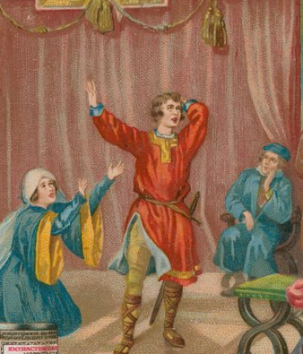
Lighting
Types of Theatre Venues
  Outdoor
    Indoor
    Outdoor Venues
      Mostly used skylight.
      Actors would carry candles to signify that it was night.

Slide 4
Lighting
Indoor Venues
  Lit by chandeliers with candles.
    Risked wax dripping on the actors frequently.
    They would adjust the intensity by lowering and raising the chandeliers.

Slide 5
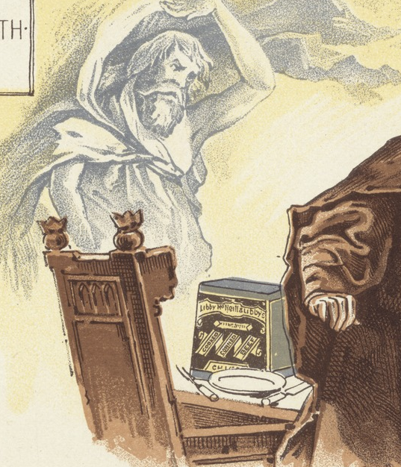
Special Effects
They had a very casual relationship with explosives.
  Making Lightning
    Swevel: Fixed wire from the roof to the floor. Lit a fixed firecracker to it, and it shot from the top of the wire to the bottom.
    The other way they would achieve this is by throwing resin powder on a candle flame.

Slide 6
Special Effects
Making Magic
  They used fire “as little as possible.”
  They could make black, white, yellow, and red smoke.
    Depended on the chemicals they mixed.
    [Something about smells of them goes here but I have to find it again].

Slide 7
Special Effects
    They had no life preservation skills.
    The effects were very dangerous and smelt horrendous.
    Sulphur smelt like rotten eggs.
    Saltpetre, made from dung, obviously smelt horrendous when lit ablaze.
    Both were used to make gunpowder.
    To “breathe fire” they would put firecrackers in their mouth. They were simply gunpowder put in rolled paper.

Slide 8
Special Effects
    Blood on Stage
    To get “fake” blood on stage they would use animal blood.
    For bloodier productions they would fill an animal bladder with blood.
    For less bloody affairs, they would use a handkerchief soaked in blood.
    Other methods include:
    Replacing the actor with a bloody dummy.
    The insides of animals

Slide 9
02
Costume/Hair/Makeup Design

Slide 10
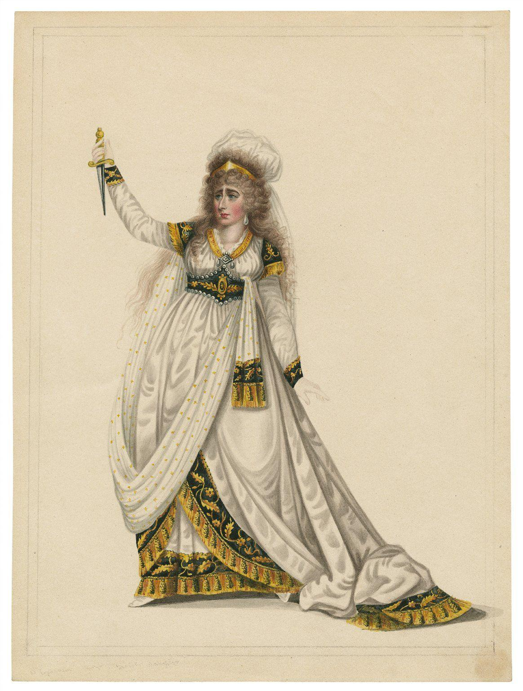
Costumes
Clothing was all from the renaissance era
  If a play was from a different time period, some of the costumes were made to vaguely look like the intended time period, while still exhibiting traits of renaissance clothing. (---->)
Donations were made by nobles
  Purple silk and sable fur = only royals
  Crimson velvet = Dukes, marquises and earls
  Tinseled cloth = viscounts and barons
  Gold, silver, and pearl embroidery = Reserved for dukes, marquises, earls (including the children of all three), viscounts, barons, and Knights of the Garter.
  Enameled buttons, chains, etc. = upper nobility, wives of baron's sons and wives of knights
  Silk, satin, and damask = all of the above plus the daughters of knights

Slide 11
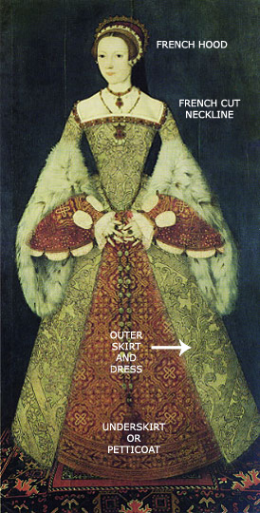
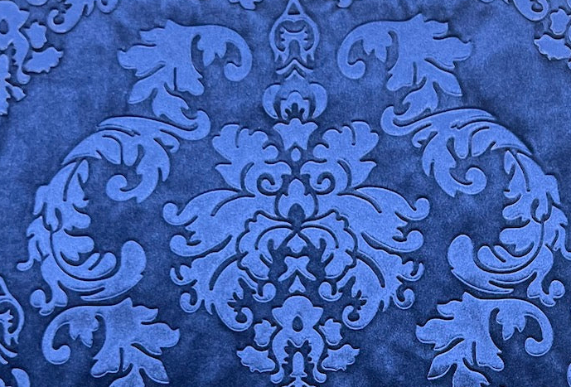
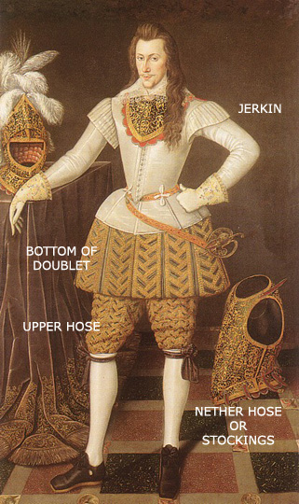
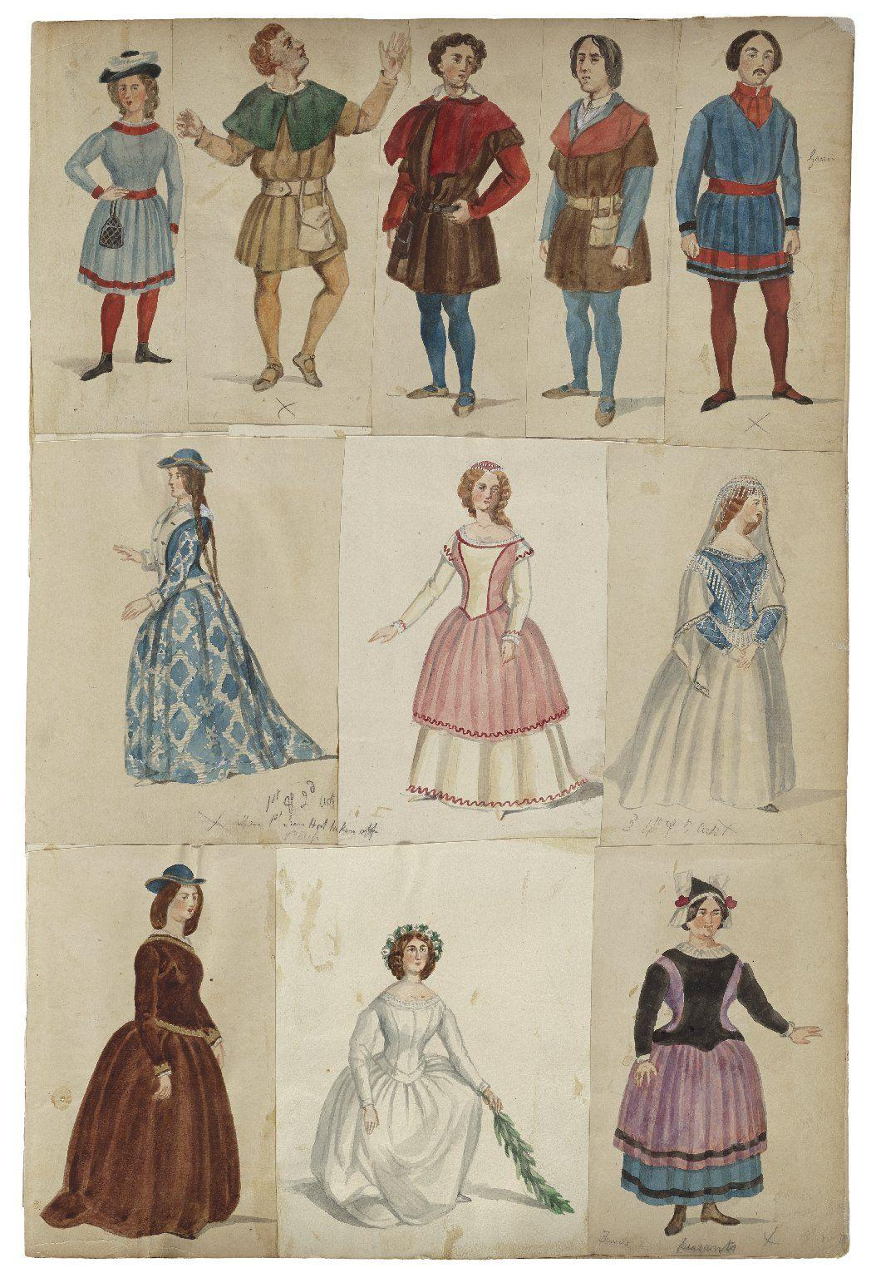
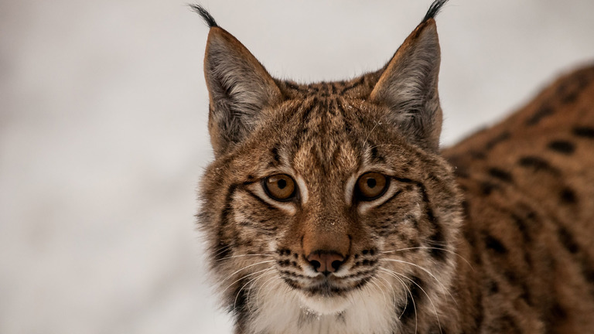
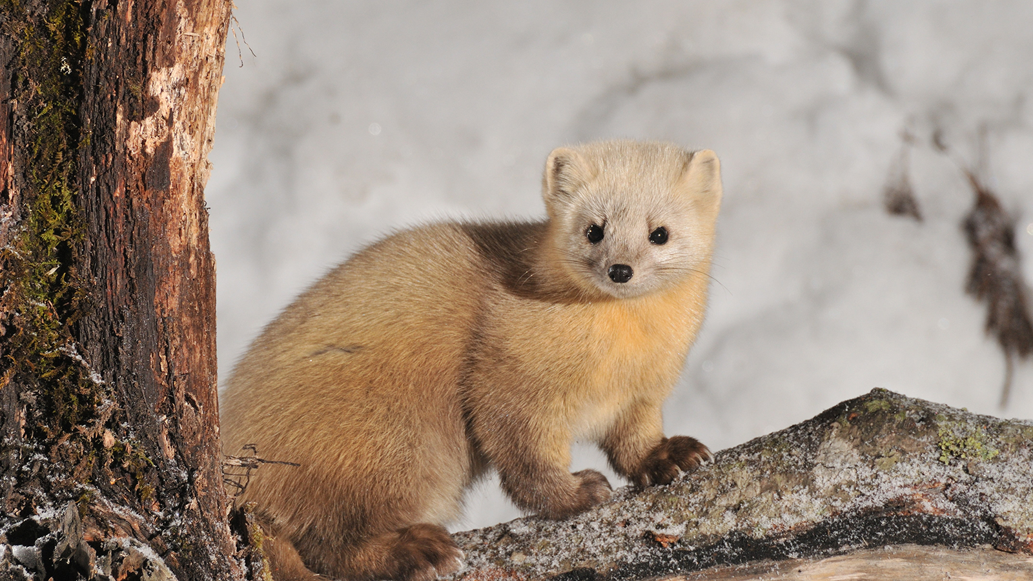
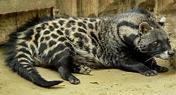
Renaissance Clothing

Slide 12
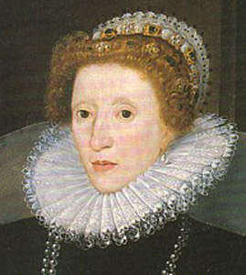
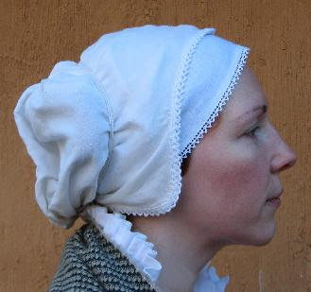
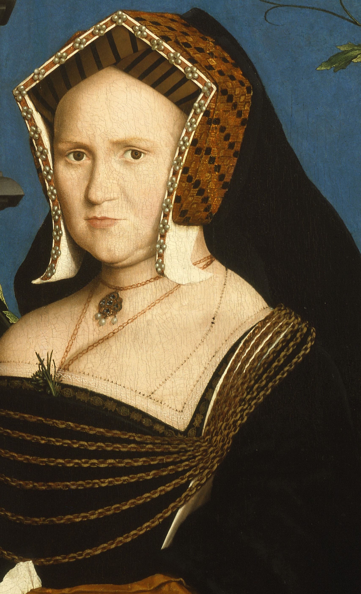
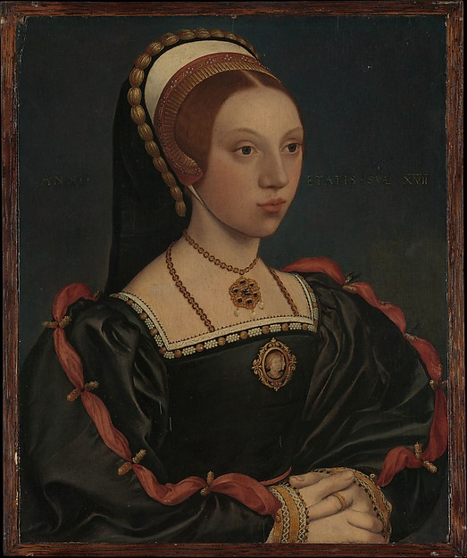
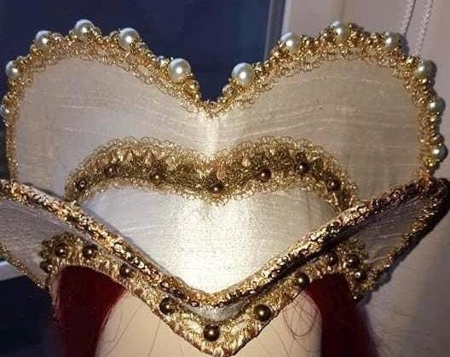
Women's Hair
Wigs were used, as well as styled natural hair
In comedic plays, hair shapes were exaggerated
Red, White and Yellow were the most popular on-stage hair colors due to Queen Elizabeth
Women's hair was long, often curled. If they were unmarried, they would show off their long hair, and if they had a ring on their finger, they had their hair in an updo.
  Fun fact: they would dye their beards to coordinate with their outfits
Headwear was also popular at this time. Popular head coverings at the time for men's fashion include:
  Coif
  Caul
  French/English Hood
  Attifet

Slide 13
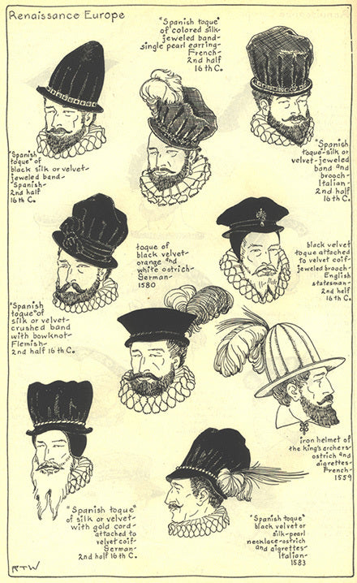
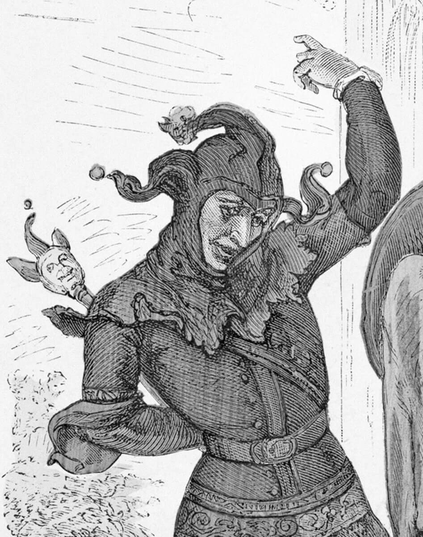
Men's Hair
Wigs were used, as well as styled natural hair
In comedic plays, hair shapes (including facial hair) was exaggerated
Red, White and Yellow were the most popular on-stage hair colors due to Queen Elizabeth
Men's hair was either cut short, brushed up and held with gum, or kept long and curly (sometimes put in a ponytail)
  Fun fact: they would dye their beards to coordinate with their outfits
Headwear was also popular at this time, and determined social status based off the height of the hat. Men's hats from this time include:
  Muffin cap
  Tall crown hat
  Flat cap/Toque
  Fool's cap

Slide 14
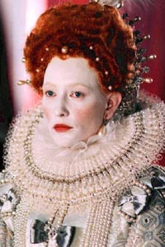
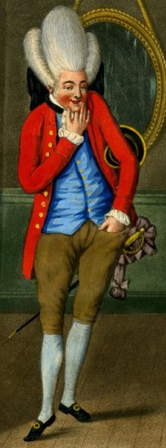
Makeup
Romanticizing tuberculosis symptoms! (pale skin, flushed cheeks)
Pale skin, achieved through using a led and vinegar mixture (most commonly used by nobility)
  Other methods were also popular to achieve this complexion as well
  Egg whites were used to glaze the skin sometimes
  Caused skin damage, which they would treat with donkey milk, lemon juice, tree sap, sulphur, or a mercury "face peel"
  Also drew moles to hide blemishes caused by led
Rosy cheeks and bright red lips were painted on using a mercury-based pigment
Eyeshadow was made by crushing pearls and sometimes using plaster of Paris (now used in creating casts and building homes
Kohl was used to line the eyes, and they also used belladonna eyedrops to make their eyes sparkle!
Mouse fur falsies!

Slide 15
03
Sound Design

Slide 16
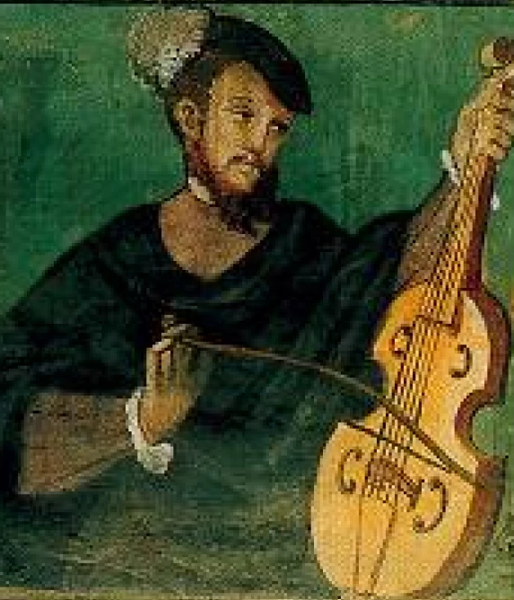
Sound
Music
  They would employ musicians to enhance the overall experience.
  There was a balcony that housed them.
  Robert Johnson (1582-1663)
  He was the most famous Globe Theatre composer.
  He composed for the first performance of The Tempest.

Slide 17
Sound
Even Sound is Dangerous
  Surprise, surprise, fireworks were used to imitate the sounds of the battlefield.
  To make the sounds of “Hell” they would use various methods.
  Musical instruments such as the trumpet, chimes, bells, and drums.
  Actors who are skilled in imitating the baying of hounds, crowing of roosters, or ghostly wailing sounds.

Slide 18
Sound
Less Danger, Shockingly
  To simulate thunder, they would use a metal sheet… OR
  In what is most likely their safest use of cannons yet, simply rolling a cannonball.
  Safer Sounds
  Bird Whistle, for birds.
  Wind was made via a machine called the Aeliophone.
  How it works is it’s a large cylinder covered in parchment of fabric that is turned to make the sound.

Slide 19
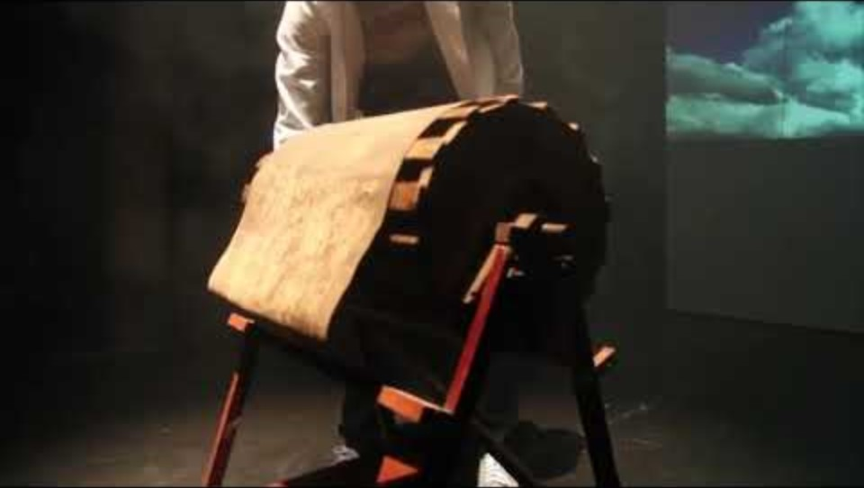
Wind Machine -Aeliophone

Slide 20
04
Set Design and
Props

Slide 21
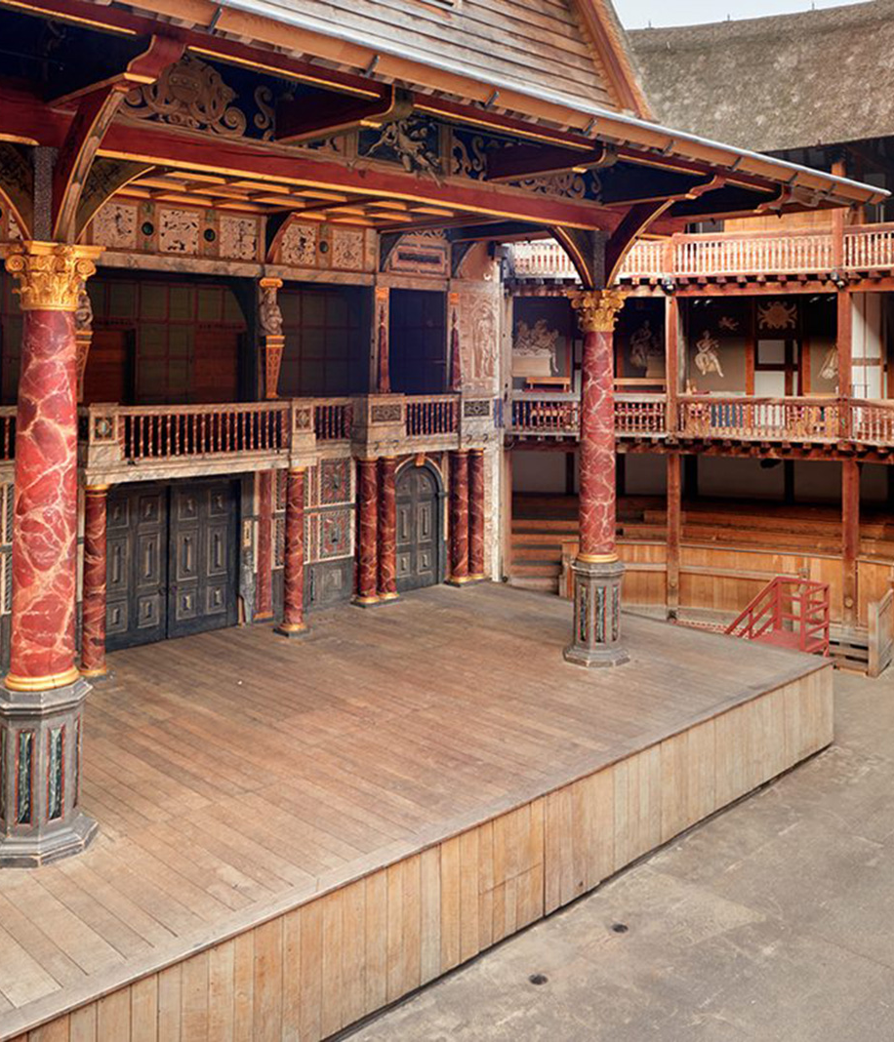
Set Design
Set Pieces
  During this period, sets were not as we know them today.
  They would only have items that were discussed in the script.
  Such as a throne, grave, or bed.
  Spoken décor was how the environment was set.
  The environments of the play were described to the audience rather than depicted physically.

Slide 22
Set Design
Heaven and Hell
  The stage was built with vertical options in mind.
  Actors could descend from “heaven” above the stage.
  They could also come up through a trapdoor from “hell”.
  These are what they were used for a lot of the time.

Slide 23
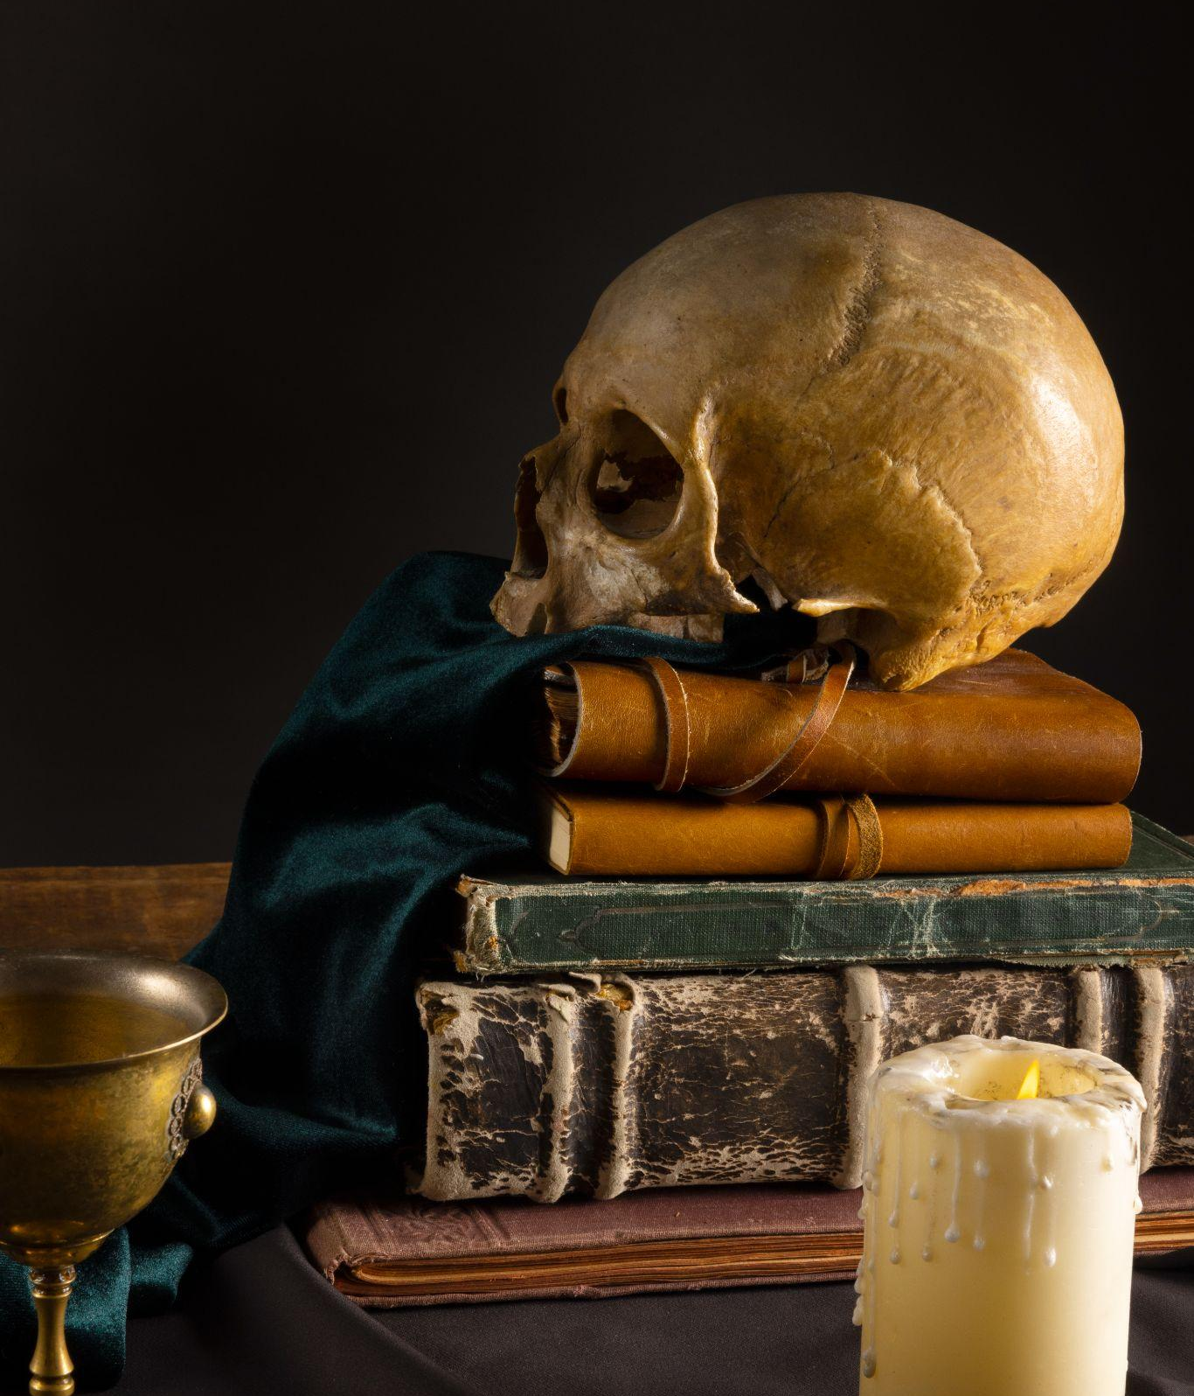
Props
What You Would Expect
  During this time, props were a very important part of the production since the set was basically non-existent.
  However, there wasn’t really anything out of the ordinary that we haven’t touched on already.
  It’s what you would expect to be available.
  Sword, Books, Skulls and Bones, the usual.

Slide 24
Props
Bones
  It actually isn’t that interesting. They likely used animal bones when they needed to use bones.
  Some suggest they could have used human bones but have no proof beyond that in England at the time they would exhume old graves to make space for new ones.

Slide 25
And that’s the end.

