Slide 1
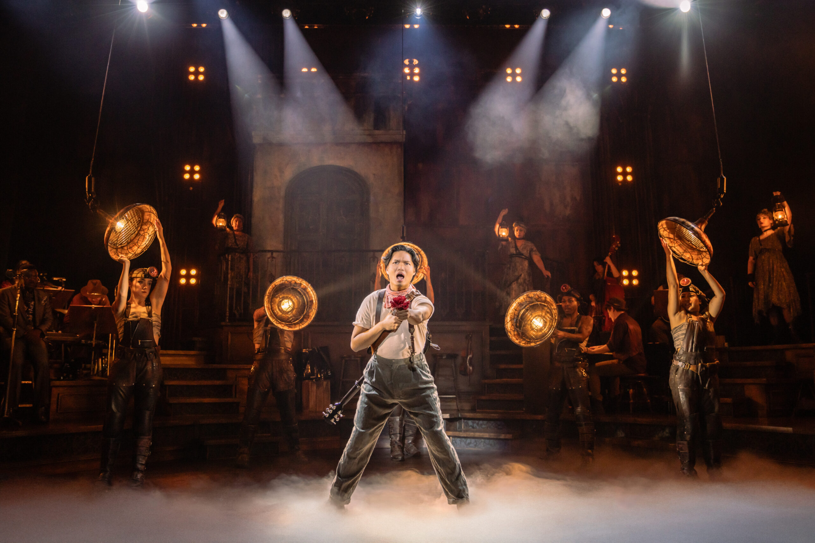
Scenic Design
Presented to you by
Jordan Miller and Preston Reynolds
Hadestown - Scenic Design by Rachel Hauck
*This 40 minute lesson plan is intended for middle or high school grade levels. (aspects have been adjusted to account for the context of this class)
Notes:
Note: Stagecraft Fundamentals, A Guide and Reference for Theatrical Production, Fourth Edition was used as a skill level reference for this presentation. Most of the images are also from that book. Photos credited in notes of each slide.
(Photo courtesy of Evan Zimmerman for MurphyMade)

Slide 2
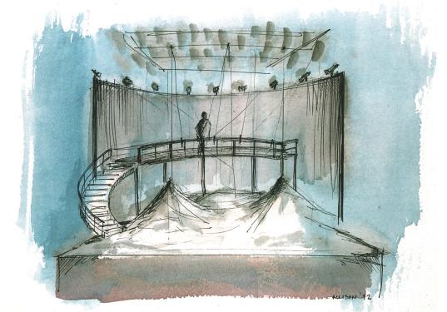
What is Scenic/Set Design?
It is the art of creating scenery for theatrical, film, and television productions.
What does it mean practically?
  Reading and Analysis
  Collaboration
  Composition
  Color Theory
  Sketching/Drafting
TEKS: §117.323.(c)2C, TEKS: §117.324.(c)2C
Sketch by George Allison for a Berkshire Opera production of The Rape of Lucretia
Notes:
(Photo courtesy of Stagecraft Fundamentals, A Guide and Reference for Theatrical Production, Fourth Edition, Page 100)

Slide 3
Script analysis as a designer
We’ve learned how to analyze scripts, but...
What is the analysis process as a scenic designer?
  The first time you read a script, nothing. Just read it.
  The second time, having usually met with and discussed the director’s vision, you start asking six essential questions.
TEKS: §117.323.(c)2F

Slide 4
The Six Questions
Who? - Characters age range, attitudes, how you envision them from the script.
  For a scenic designer, this would be applied for how someone lives, what their house/room/etc looks like.
What? - Is there a driving theme to the script/story? What is the vision - natural, farcical, strange, normal?
Where? - Where does it take place? What is the size of the theatre/it’s capabilities?
TEKS: §117.323.(c)2F

Slide 5
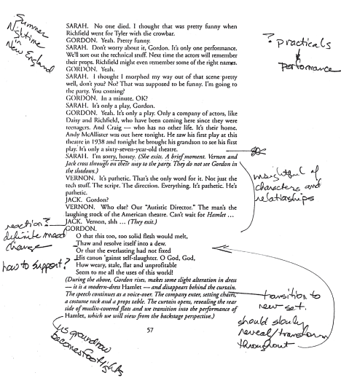
The Six Questions
When? - When does it take place?
  Time period?
  Time of day?
  Season?
Why? - Why are the characters driven to do what they do ?
  Social status
  History
How - How will each moment tell this story?
A script page with designer notes from one of the first reads.
TEKS: §117.323.(c)2F
Notes:
(Photo courtesy of Stagecraft Fundamentals, A Guide and Reference for Theatrical Production, Fourth Edition, Page 30)

Slide 6
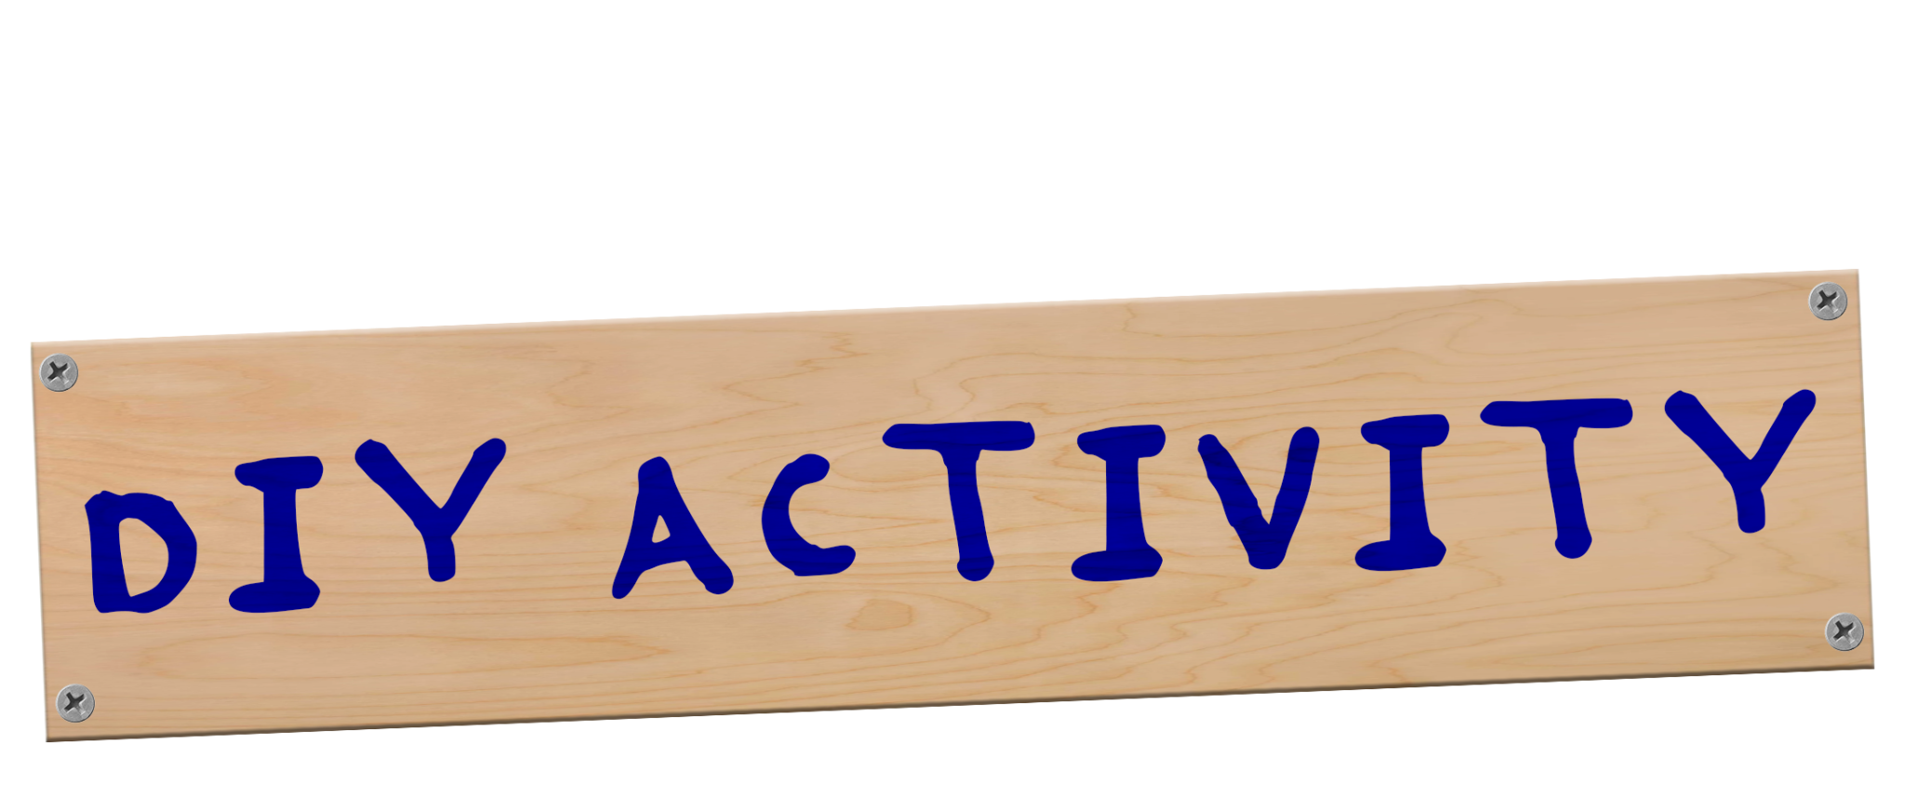
Notes:
Graphic made by me: Fonts are Montserrat and Sharpie

Slide 7
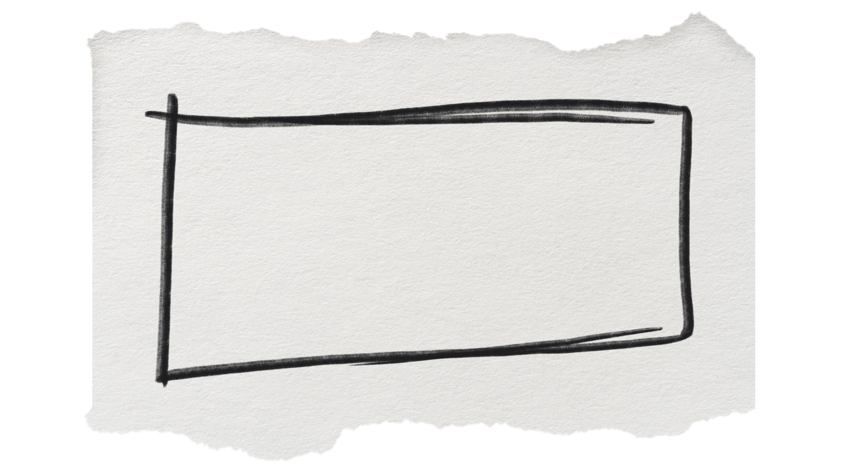
Notes:
(Paper background courtesy of FreePik, Rectangle courtesy of Adobe Stock, overall shape was me)

Slide 8
DIY Activity
Using the Goldilocks and the Three Bears as an example since we used it in class, take 3 minutes to design which ever set from the story you want.
  There are no limitations. Just have justification for your choices.
TEKS: §117.324.(c)2B
Notes:
DIY #1: Give free range to make whatever they want, while having more limited knowledge to go from.

Slide 9
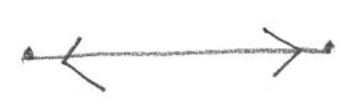
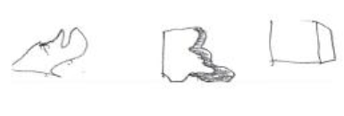
Composition
The basics for composing and drafting:
  Line and Direction:
    Line: Exactly what you think it is.
    Direction: Also exactly what you think it is.
  Shape:
    Any two-dimensional OR three-dimensional object that has created an enclosed space.
TEKS: §117.324.(c)2C
Notes:
(Photos courtesy of Stagecraft Fundamentals, A Guide and Reference for Theatrical Production, Fourth Edition, Page 50)

Slide 10
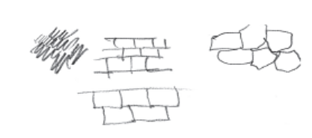
Composition
Texture:
  A 3D detail that we observe in a 2D drawing, AND/OR properties that differentiate objects of similar shapes from one another.
    Can be tactile or non-tactile.
    Tactile: Detail you can feel.
    Non-tactile: Detail you can see, but not feel.
      allude to real texture.
TEKS: §117.324.(c)2C
Notes:
(Photo courtesy of Stagecraft Fundamentals, A Guide and Reference for Theatrical Production, Fourth Edition, Page 51)

Slide 11
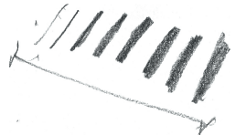
Composition
Line Weight: Once again, exactly as you’d expect.
  Determined by how much pressure you apply as you draft. For example, applying different pressures with a pencil.
  Adds interest and focuses the viewer's eyes.
    The more varied your line weight, the easier it is to define your shape.
TEKS: §117.324.(c)2C
Notes:
(Photo courtesy of Stagecraft Fundamentals, A Guide and Reference for Theatrical Production, Fourth Edition, Page 51)

Slide 12
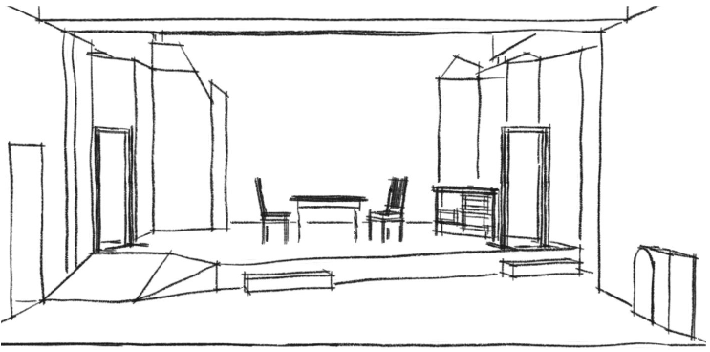
Composition
Balance and Proportion:
  Balance: In terms of drafting, it is ensuring your composition is balanced when you view it as a whole.
  Proportion: Relationship between two objects or parts of the same object.
TEKS: §117.324.(c)2C
Notes:
(Photo courtesy of Langham Court Theatre)

Slide 13
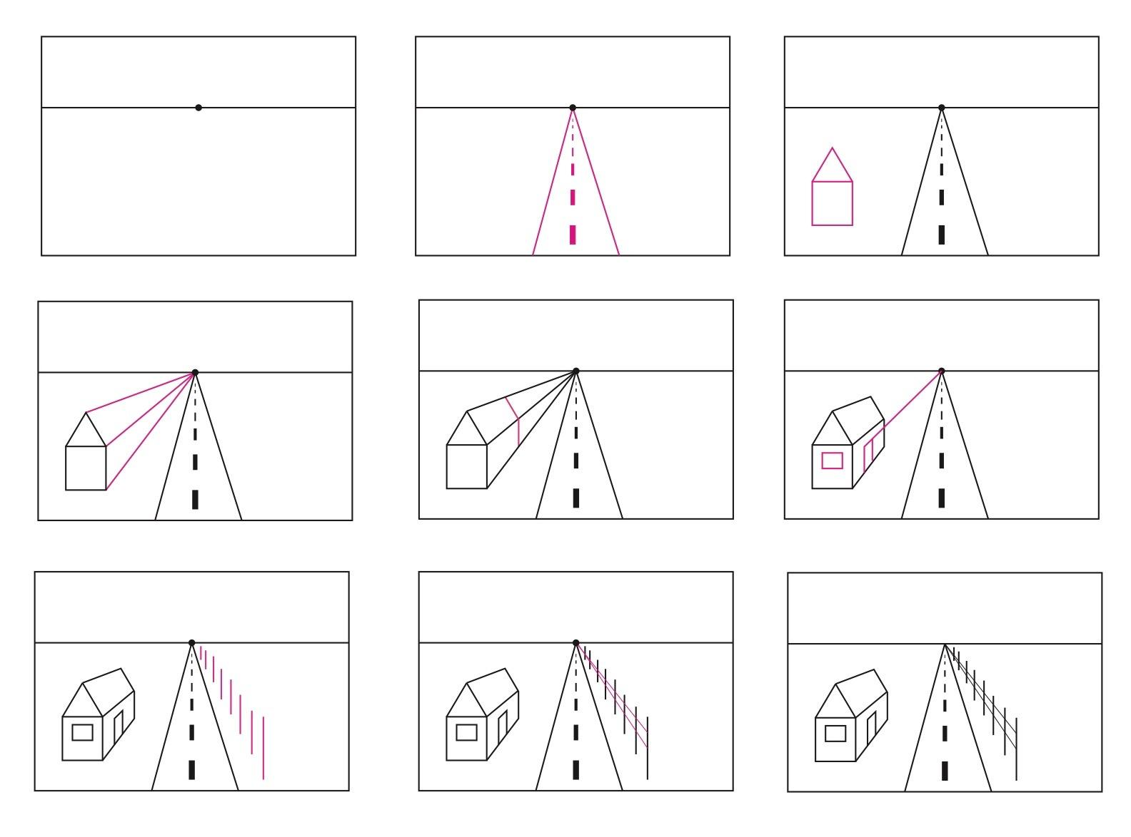
Composition
Perspective Drawing:
  2D technique to approximate a 3D object.
TEKS: §117.324.(c)2C
Notes:
(Photo courtesy of The Institute for Arts Integration and STEAM)

Slide 14
Notes:
(Photo courtesy of The Institute for Arts Integration and STEAM)

Slide 15
Notes:
Graphic made by me: Fonts are Montserrat and Sharpie

Slide 16
DIY Activity #2
Once again using the Goldilocks and the Three Bears as an example, take 5 minutes to design the set for the bedroom. This time taking what we talked about with composition. Don’t forget, have justifications for your choices!
TEKS: §117.324.(c)2B, TEKS: §117.324.(c)2C, TEKS: §117.324.(c)2D
Notes:
DIY #2: How would the design change based on thinking about composition? Do things get removed? Do they get completely reimagined?

Slide 17

Color Theory
The ABSOLUTE basics of color theory:
  Colors are organized through color wheels. HOWEVER, it is important to note that there are 2 different color wheels used within theatre.
    Commonly known: Paint and Pigment
    Lighting
TEKS: §117.324.(c)2E
Notes:
(Photo courtesy of Stagecraft Fundamentals, A Guide and Reference for Theatrical Production, Fourth Edition, Page 60)

Slide 18

Color Theory
Primary colors: Can’t be created by mixing any other colors together.
  Red
  Blue
  Yellow
TEKS: §117.324.(c)2E
Notes:
(Photo courtesy of Stagecraft Fundamentals, A Guide and Reference for Theatrical Production, Fourth Edition, Page 59)

Slide 19

Color Theory
Secondary colors: Created by combining any two primary colors.
  Purple
  Green
  Orange
TEKS: §117.324.(c)2E
Notes:
(Photo courtesy of Stagecraft Fundamentals, A Guide and Reference for Theatrical Production, Fourth Edition, Page 59)

Slide 20

Color Theory
Interpreting Color:
  Firstly, think about which colors are warm, and which are cool.
    Warm colors are reds, oranges, and yellows.
    Cold colors are greens, blues, and purples.
TEKS: §117.324.(c)2E
Notes:
NOTE: If we covered more than basics we’d go into tints, shades, and tones.
(Photo courtesy of Stagecraft Fundamentals, A Guide and Reference for Theatrical Production, Fourth Edition, Page 60)

Slide 21
Color Theory
Colors have meaning:
  Warm colors are energized and vivid.
  Cool colors are recessive and appear as if they are receding.
    Results in them being perceived as calming and soothing.
  Using the opposite set of colors can be used to make balance.
TEKS: §117.324.(c)2E

Slide 22
Color Theory
Colors have SPECIFIC meaning:
  We react to color. But reactions can differ on how and where it’s used.
    Example: Red can mean anger/danger/warning, OR it can mean passion.
    How does where matter?
      Example: In America we wear black to funerals. However, in China they wear white.
        It’s important to know this not only for your audience, but also the time and place your show may be set.
TEKS: §117.324.(c)2E

Slide 23
Collaboration
Design meeting:
  There are often multiple. You will be working with other designers to make a cohesive production in line with the director's vision.
    Early design meetings will be used to discuss thoughts and ideas with the other members of the design team. You will use this information to go and create your design.
    Final design meetings will be used to present your design, usually for the director to see, ask questions, and suggest changes.
TEKS: §117.325.(c)2F

Slide 24
Important to remember
When presenting your final design to a director:
No matter what, you love your design. You want to be confident in the design you’re presenting. Even if you’re not. You should be able to justify anything in your design, even if you don’t have one.
  Did something poorly or wrong? Design choice.
  Don’t like how it turned out? Don’t care, design choice.
  Spilled coffee on it? Well, don’t do that. Design choice.
With all of that in mind, you still must be willing to change your design.
  This doesn’t mean you have to cave on everything, you can justify why you think something is important.
TEKS: §117.324.(c)5D, TEKS: §117.325.(c)2F

Slide 25
Notes:
Graphic made by me: Fonts are Montserrat and Sharpie

Slide 26
DIY Activity #3
Using Goldilocks and the Three Bears, take 10 minutes to design the set for the bedroom. However, this time the “Director” has given you some limitations.
Such as the following:
  You can only use what is available as part of the UIL One Act Play set.
  No furniture. All furniture will be made out of the UIL set pieces.
  You CAN use props and set dressing.
Remember, have a justification for the choices you make!
TEKS: §117.323.(c)2C, TEKS: §117.324.(c)2C, TEKS: §117.324.(c)2E, TEKS: §117.324.(c)5D
Notes:
DIY #3: How does the design change once you have a production meeting? Again, does it all get thrown out, can some of it remain?

Slide 27
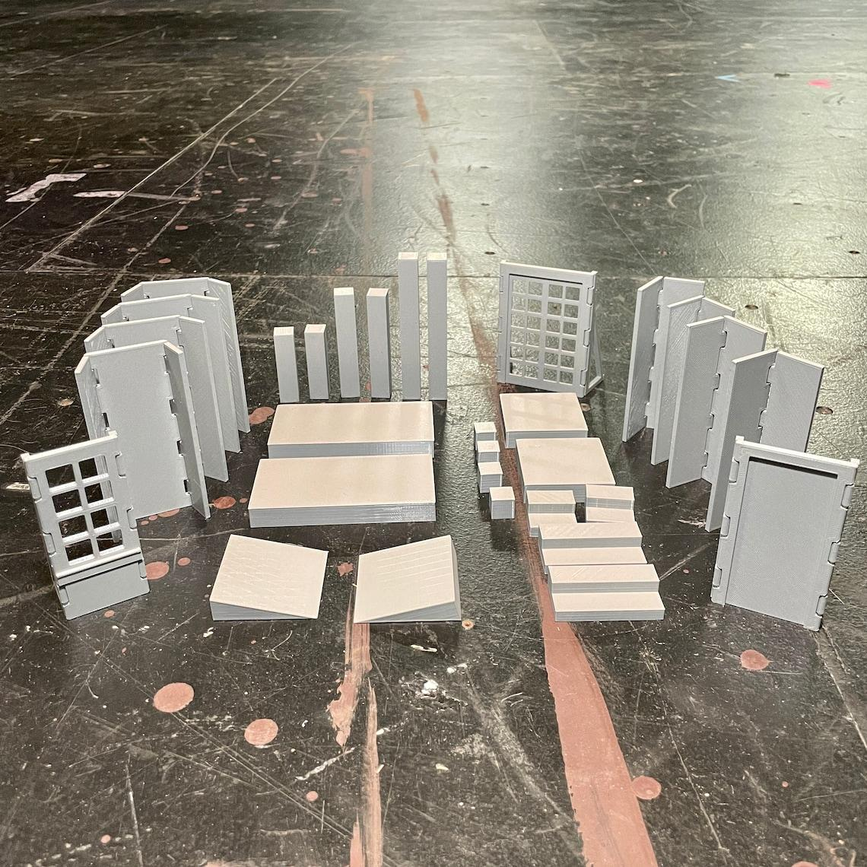
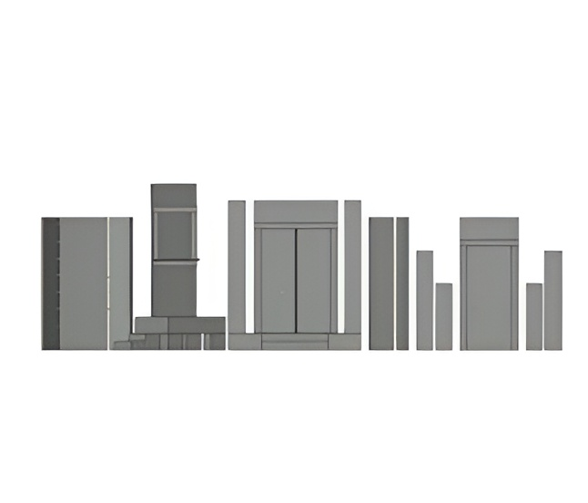
  You can only use what is available as part of the UIL One Act Play set.
  No furniture. All furniture will be made out of the UIL set pieces.
  You CAN use props and set dressing.
Notes:
(Photo courtesy of MightyWithAllTrades and www.tabletopscenicdesign.com)

Slide 28

Notes:
Instructional Instructions: Ask for volunteers to present their design to the “production team,” those who are not presenting their set can ask a question about why something is the way that it is. (Limit to 2 questions asked per presenter).
Goal: Demonstrate standing by your choices, no matter what you feel about it. (This is very much stealing strategies from Donna and editing them to fit here).
(Graphic edited by me; calendar by: Free Icons PNG, Fonts are Montserrat and FG Liv Regular < (Only place I could still find it, pretty sure it was a paid font at some point. I have a million fonts so not sure.)

